Slide 1
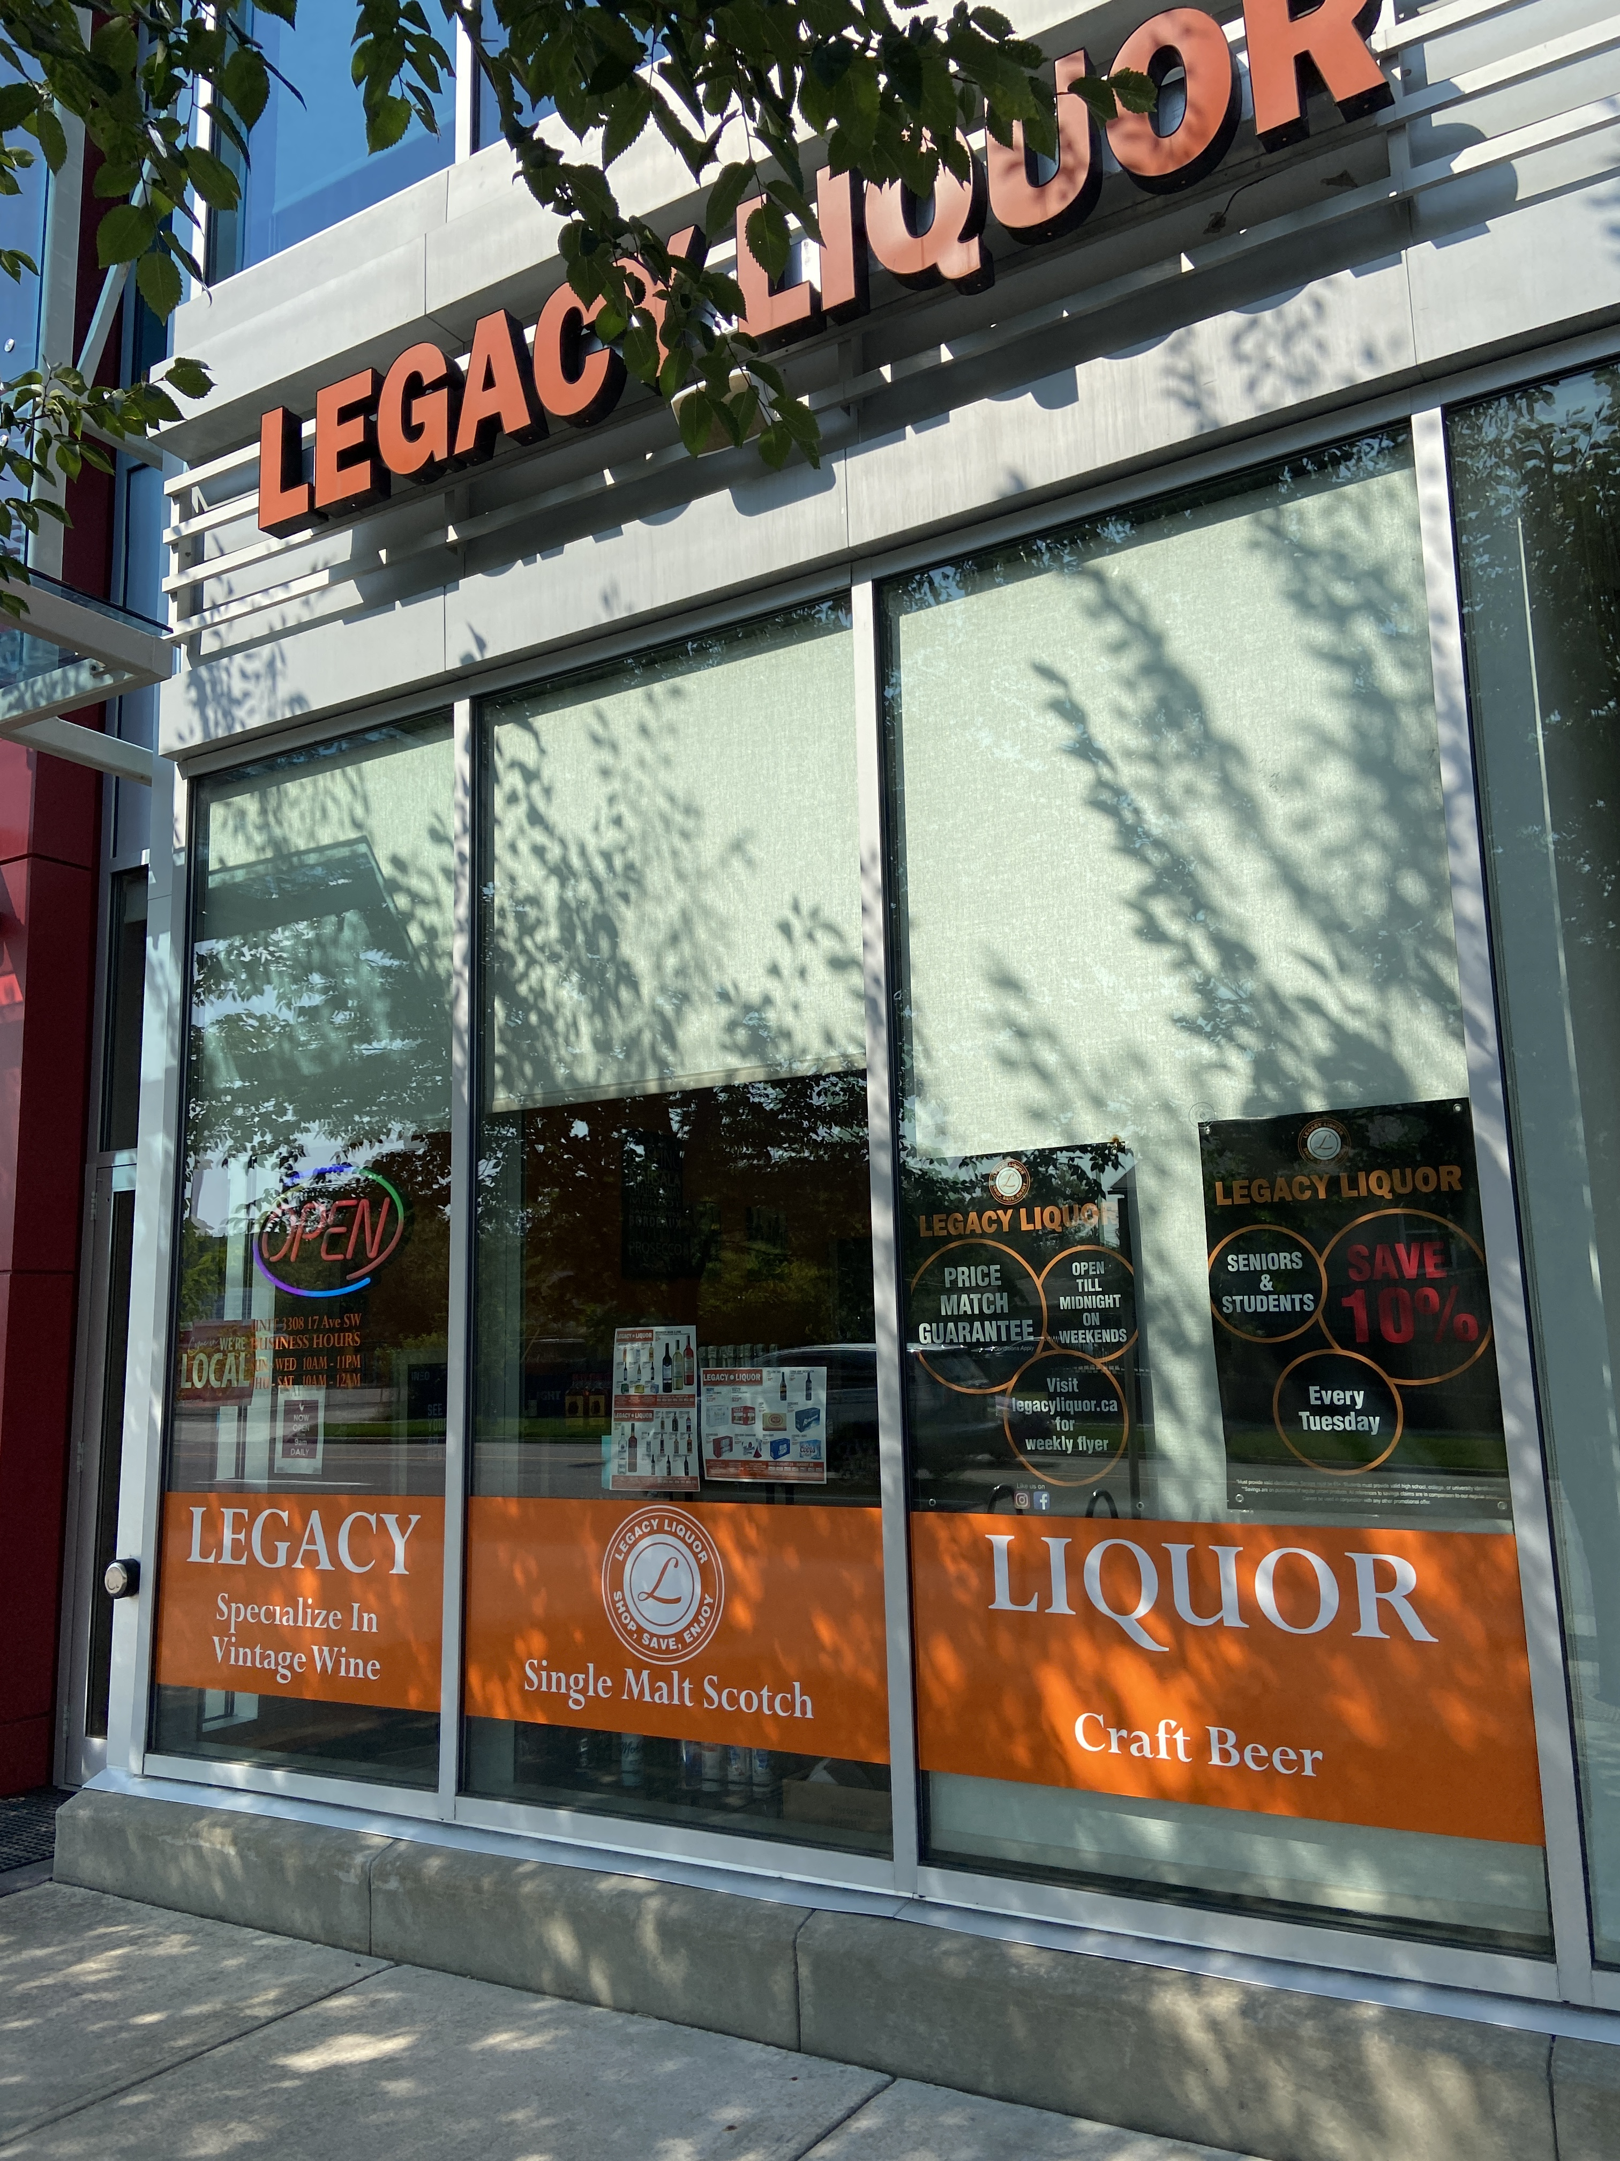
Business Data Management Inventory Management & Pareto Analysis for a Retail Liquor Store
Indian Institute of Technology, Madras
Harmanpreet Singh
21f3002026@ds.study.iitm.ac.in
21F3002026

Slide 2





ABOUT THE COMPANY
Legacy Liquor is a small retail liquor store chain
Type of Business: B2C
Specializes in vintage wines, premium spirts and a sea of handmade
beers
Owns a total of 4 stores across town
Situated in Calgary, AB
Canada

Slide 3
Problems
Inventory Management
Pareto Analysis
Daily Sales
To identify and distinguish
the dead stock among
traffic builders
To identify Top performing
SKUs, to prevent
their Stock-outs
To determine the cause of
plummeting daily sales

Slide 4

Data Journey
Collection
Collected from store’s Point-of-Sale system
Inventory records of around 15-20 items per department
Analysis I
Creating a “Scale” for objectives 1 & 2
Geo Analysis for objective 3
Results & Findings
Transforming insights to suggestions
Cleaning
XML files to Macro Workbooks
Store’s ledger spanning 14 months of data
Analysis II
Making box plots
Determining correlations
Finding trends in data

Slide 5

Assigning “Score(s)”
Finding the item’s probability of
being sold
Scoring it based on its Popularity & Probability
$$Score= \frac{Probability+Popularity}{2}$$

Slide 6
Dead Stock VS Traffic Builders

Slide 7
Fast Movers (Whiskeys – 1 of 6)

Slide 8
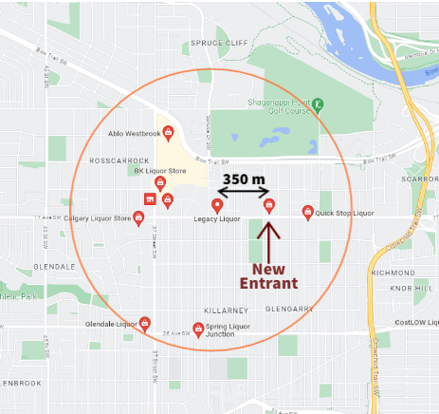
Closeness to Competitors
7 Competitors within circle of radius 1 KM
With addition of a new entrant in December 2022

Slide 9
Recommendations
Popularity Tracking
1/5th Items labelled Dead Stock
Managers should be aware of an item’s popularity
Various resources on web
Customer Request Form
To maximize sales probability
Extended control to customers
Lookout for Top Sellers
To always keep an eye on fast movers
Buy in bulk, during limited time offers
Prevent Stockouts
Destination Merchandise
Broaden the customer base
Include competitors’ products
Include additional items

Slide 10
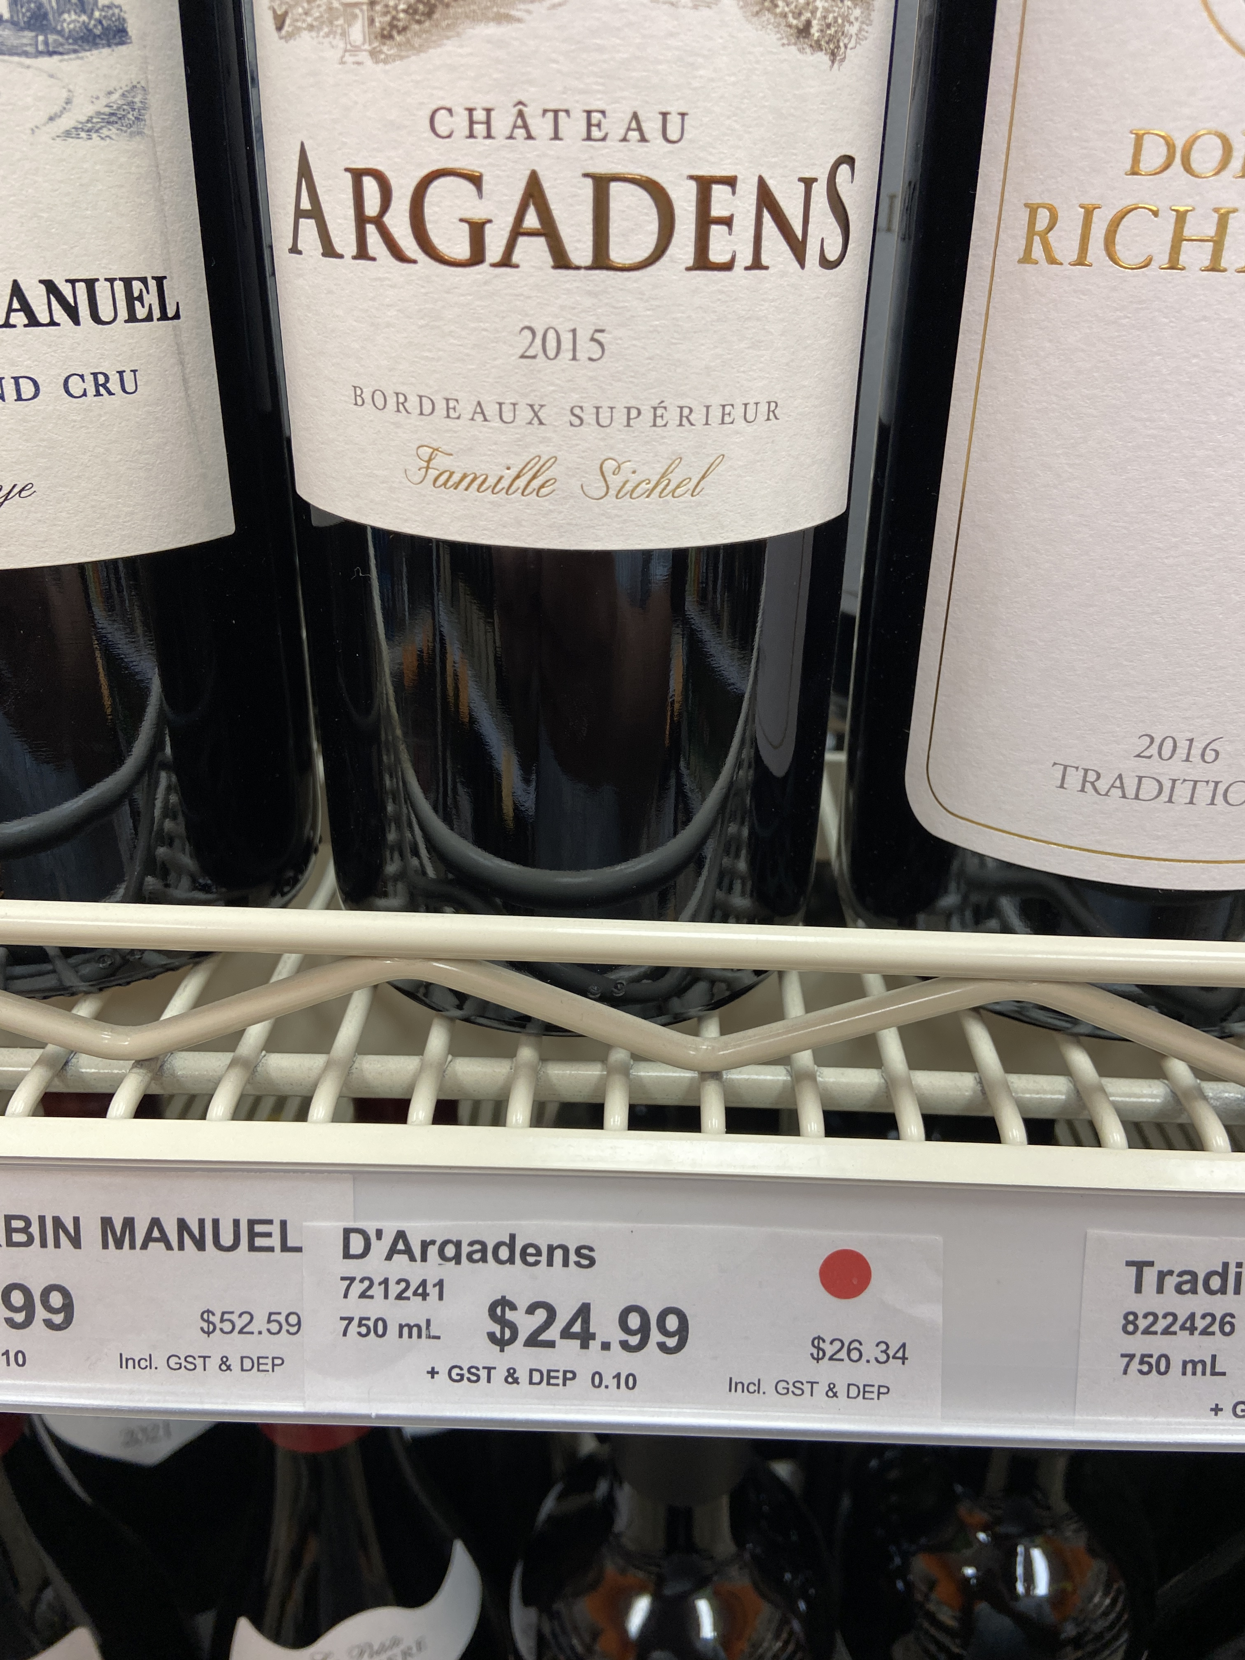
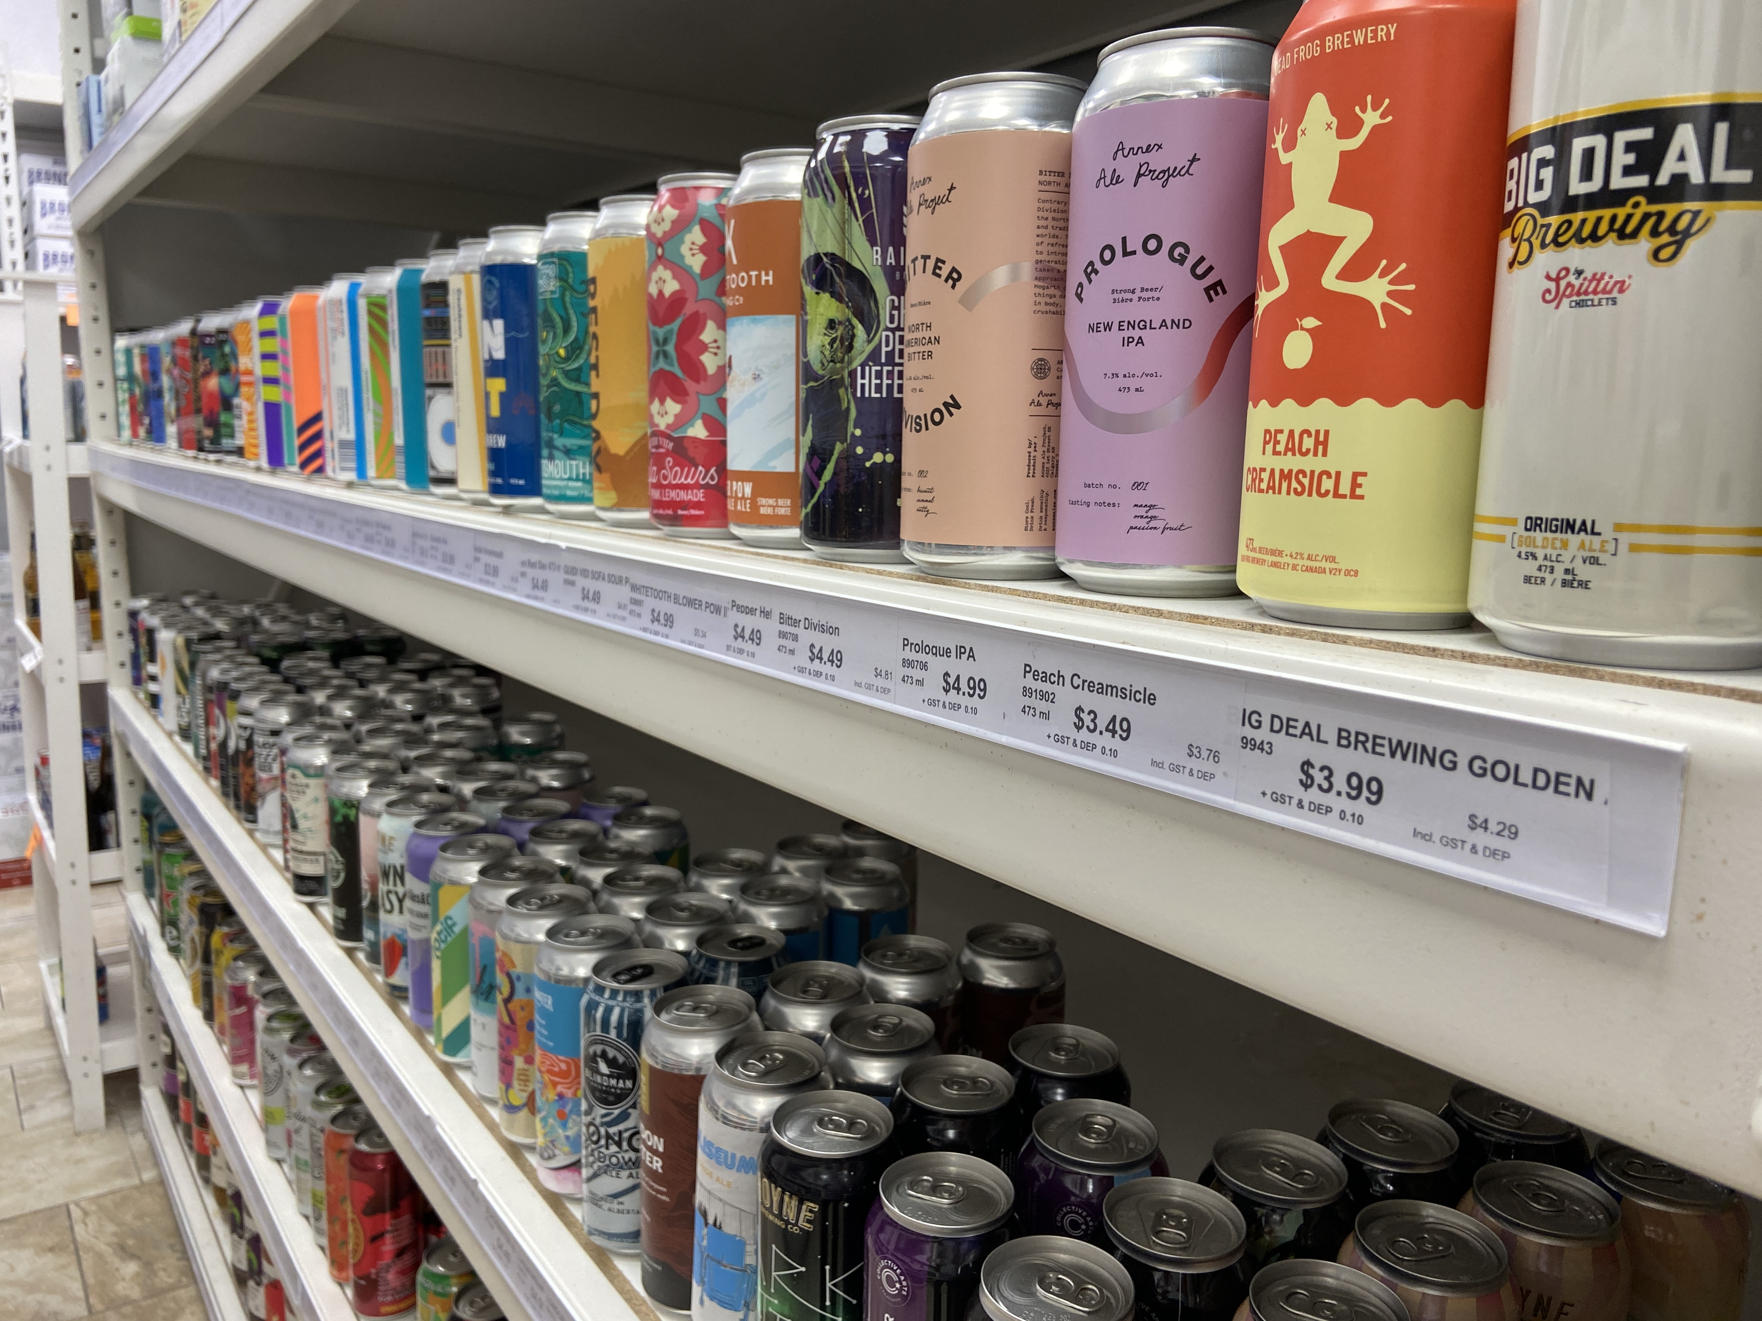
THANK YOU
Open to Questions !
Harmanpreet Singh
21F3002026

